Slide 1
FIBA 2015 2-Person Mechanics Changes

Slide 2
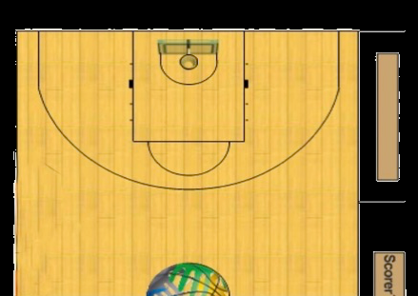
Lead
Working on the baseline
Keep torso toward front of rim (45°)
and adjust position with ball to
maintain open (wide) angle
Field of vision should enable you to
see horizontally and vertically as
clearly as possible (keep distance
from play)
Find the initial position where you
are able to cover the next play
situation (anticipate the next play)

Slide 3
Warning Whistle
When a throw-in is taken on the endline in the frontcourt, Lead official will blow the whistle before placing the ball at the player’s disposal for the throw-in.

Slide 4
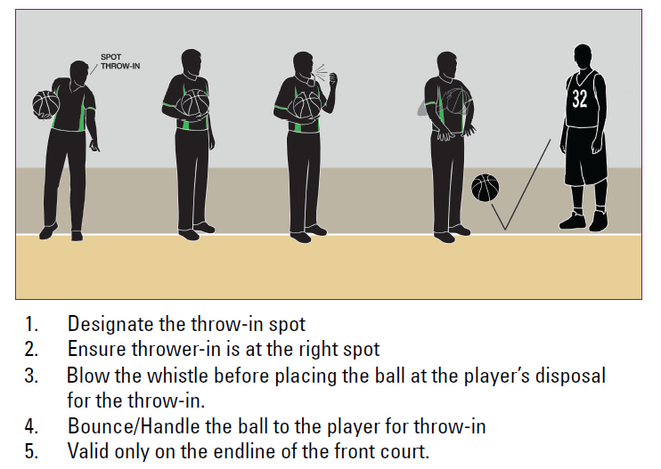
Throw-in/Warning Whistle

Slide 5
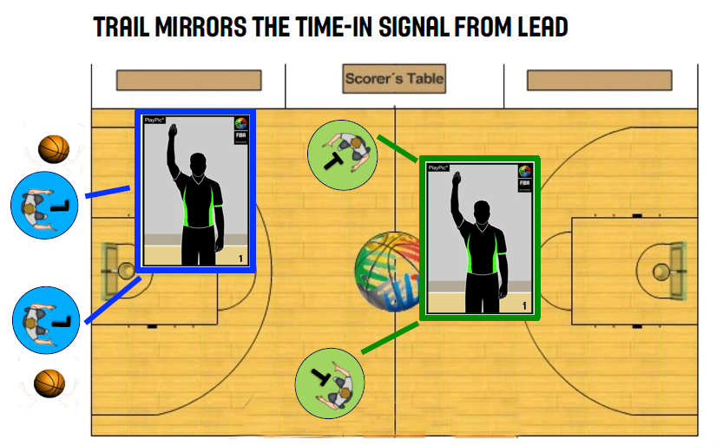
Throw-in Frontcourt Endline

Slide 6
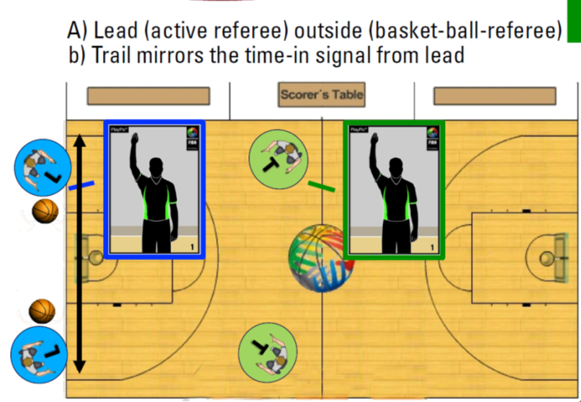
Throw-in Frontcourt Endline

Slide 7
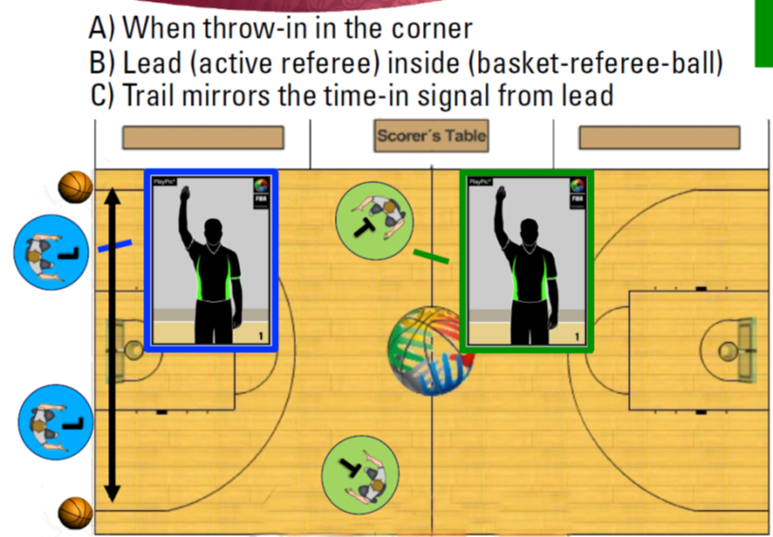
Throw-in Frontcourt Endline

Slide 8
Time-outs
Leave the ball where the game will be resumed
Excellent time to communicate (together)
20secs remain - move close to the team benches
10secs remain – break huddles and leave, if you go back it’s to warn for not breaking huddle

