Slide 1
FIBA 2 Person Mechanics
August 2012

Slide 2
Preparation Before The Game
arrive 1 hour before start time
report to organizing body/commissioner/site convenor
be properly prepared physically and mentally
take pride in presentation and dress (personal appearance is important)
uniform in good condition (clean, ironed)
no jewelry
have a pre-game

Slide 3
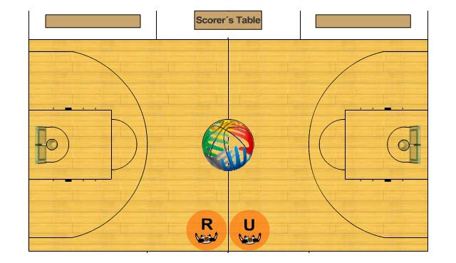
Pre – Game Positions
Visitor
Home

Slide 4
Pre-game Duties
On-court minimum 20 minutes before game
Inspect court
Take positions opposite scorer’s table
R : across from visitor’s bench/watch home team warm-up
U : across from home bench/watch visiting team warm-up
Observe warm-ups for actions that could damage game equipment i.e. grasping ring
if observed, warn coach
if repeated = technical foul

Slide 5
Pre-Game Duties con’t…
10 minutes prior R goes to table
R is responsible for approving
Game clock
Technical equipment
Scoresheet
checks score sheet is properly filled out
Coaches have confirmed names and numbers by signing sheet and have indicated 5 starters
Note:
Assistant coach(es) is listed if one
Ask /remind coach if ALL players are listed
Selects a used game ball

Slide 6
Pre-Game Duties con’t…
If the game has introductions
6:00 minutes R blows whistle and officials to table
Once introductions over:
R blows whistle and indicates 3 minutes to play
Clock starts count down again at 3:00
Teams can continue warm-up
1:30 R blows whistle; teams go to benches
Before jump ball the
verifies ready to stat game
verifies no illegal equipment is being worn
identifies the captain of each team

Slide 7
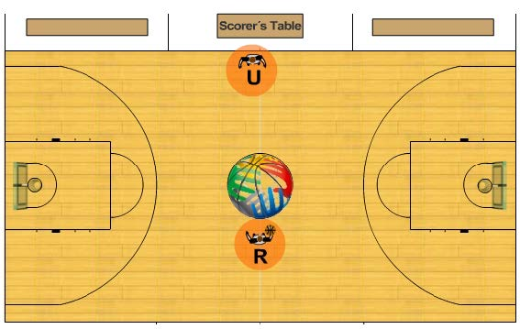
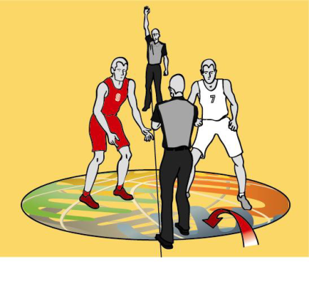
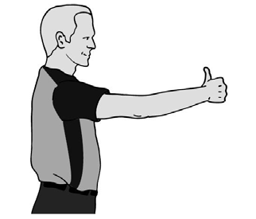
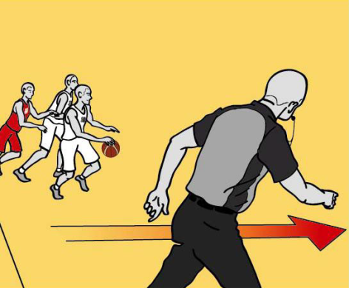
Starting Game/Jump Ball
Umpire
Checks table, eye contact and thumbs-up to referee
Puts up arm
On tap, chops in time and moves with ball
Referee
Whistle out, gets thumbs up
Steps in and tosses
After tap
Puts in whistle
Stays until clear and moves to position
Check clock and arrow

Slide 8
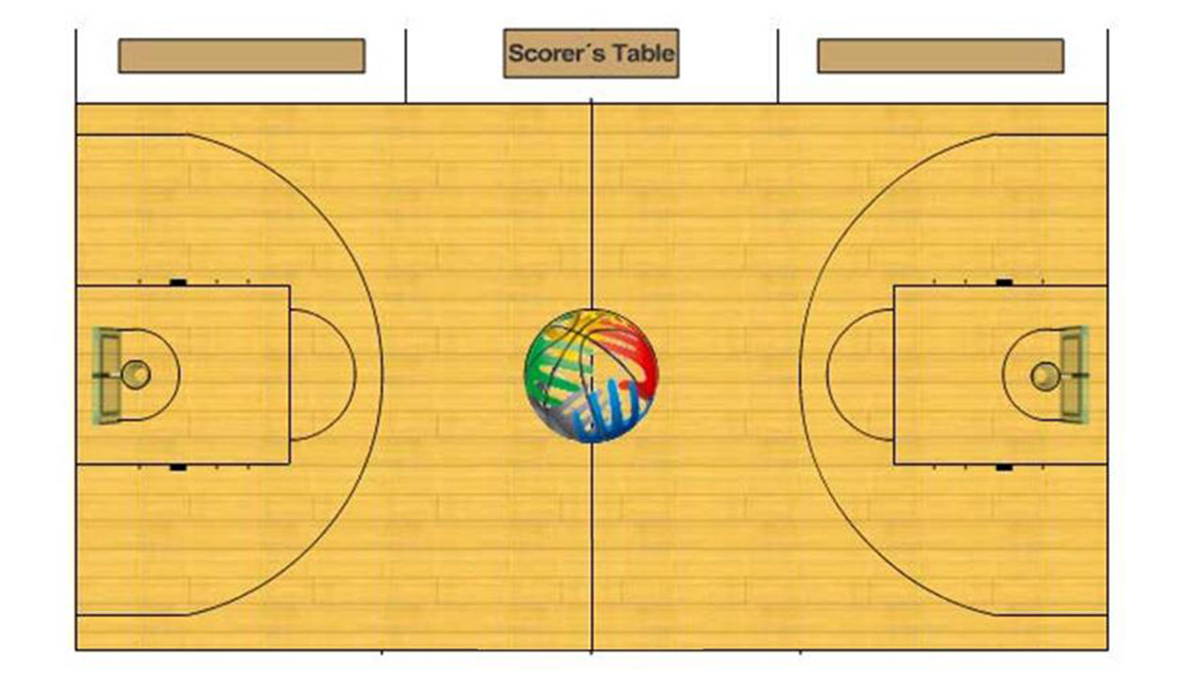
Ball Goes to Referee’s Right
Note:
Canadian modification
not following “work left” mechanic
Umpire gets a head of ball and becomes Lead
T
Referee goes opposite and becomes the Trail

Slide 9
Court Coverage/Officiating Techniques (both officials)
Be aware of players, ball and partner
keep eyes roving
knowing where the ball is isn’t same as following it
One official responsible for on ball and the other for play off-ball (dependent on location of ball)
Seek to box players in (physically and/or visually)
Try to obtain best possible position to judge the play
“Go where you need to go in order to see what you have to see”
Move as necessary when the ball moves
Look for spaces between players
Use manual as a guideline

Slide 10
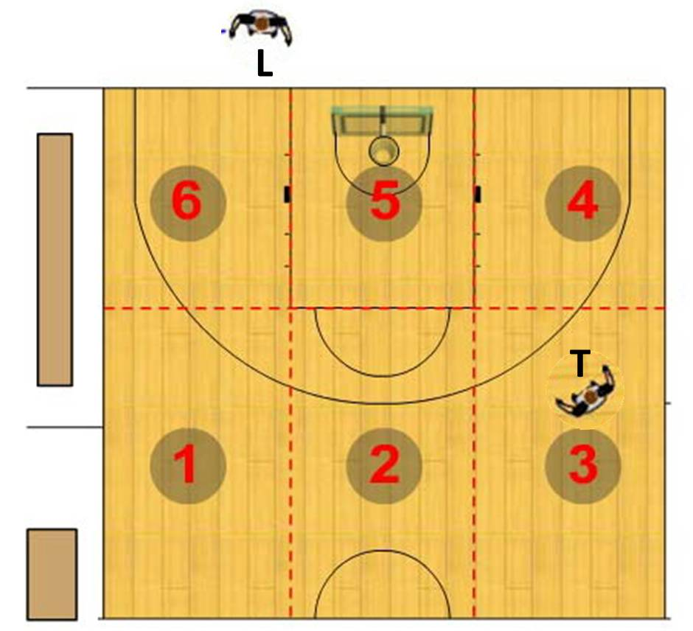
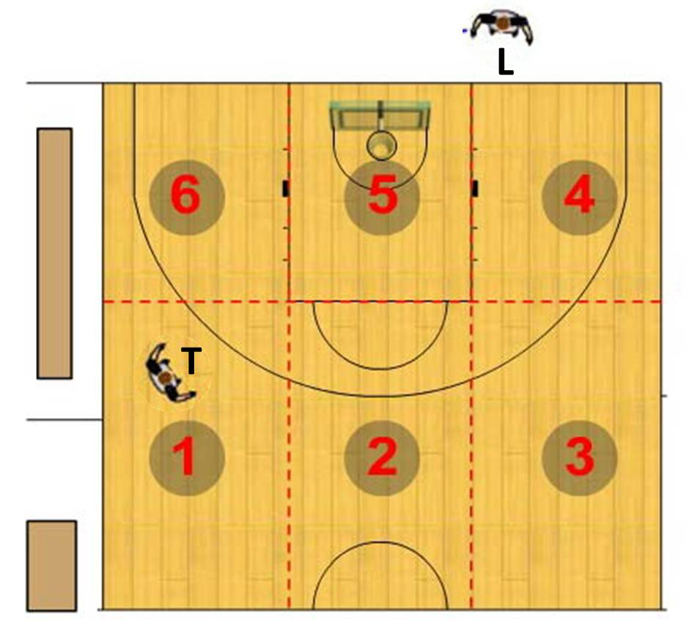
Court Coverage Areas
Court coverage rectangles remain are ‘keyed’ to table and independent of location of Lead and Trail

Slide 11
Primary Duties of Trail
Two and three-point field goal attempts including judging time expiration
shot clock violation
end of period
Goal tending and interference
Rebounding situations, in particular “over-the-back”
Low post area, in particular weak side/away from ball
Fouls away from lead official
Travelling violations (when Trail has the best angle of vision)
Twenty-four second device

Slide 12
Specific Trail Mechanics
Normally behind play
slightly behind and to the left of the ball and approximately 3 – 5 m away
penetrate to the free throw line extended (approximately) when the ball penetrates towards the basket or the endline on a pass, dribble or shot, in order to better find the spaces between the players

Slide 13
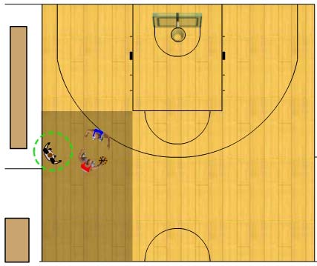
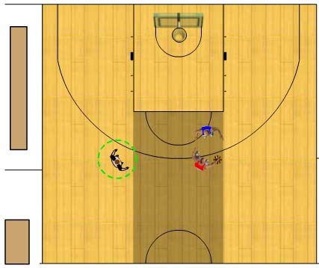
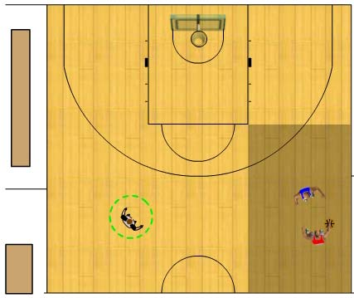
Trail Work Ball Areas 1,2 & 3
Note:
movement onto court/working the arc
Note:
Working to see spaces
Avoid passing lanes as possible

Slide 14
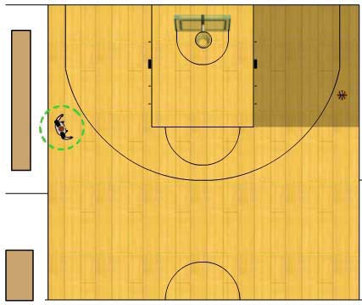
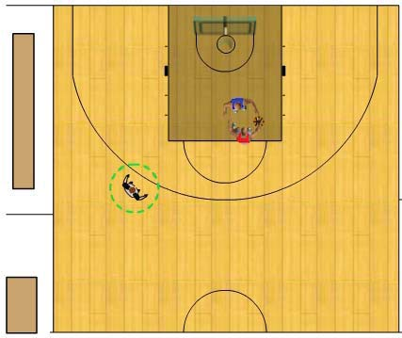
Trail Work Ball Areas 4 & 5
Off-ball
On-ball/dual

Slide 15
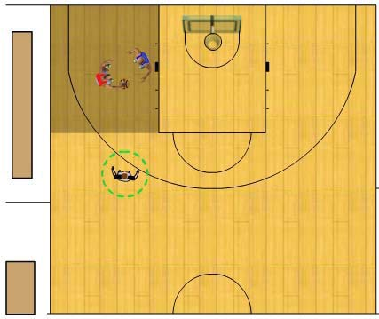
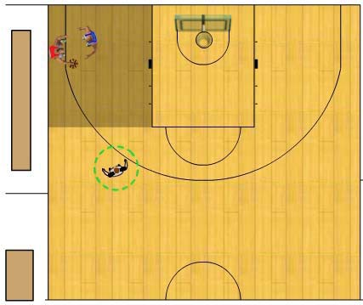
Trail Work Ball Area 6
On-ball/dual

Slide 16
Practical Advise for Trail
Positioning
Keep slightly behind and 3 – 5 m away from play moving up court
Helps to see spaces between players
Helps maintain wider angle of vision/improve court coverage
Move out onto the court as far as needed to cover play on the opposite side of the court (maintain good spacing and angle to play) i.e.
If the dribbler is closely guarded moving up the court
Trap situations just over center and/or far sideline
Penetrate to free-throw line extended whenever the ball penetrates towards the endline or basket (shot, dribble and/or pass) in order to help partner; in particular ‘over the back’/illegal contact on rebounding
"Go where you need to go in order to see what you need to see."

Slide 17
Practical Advise for Trail
Responsibilities
Line responsibilities
back court endline
closest sideline
centre line (primarily responsible - ball returned to backcourt)
Primarily responsible for shot clock; pay particular attention to the shot clock whenever the ball goes out-of-bounds
primarily responsible for the flight of the ball in all shooting situations; goaltending and interference and last second shot attempts
Be prepared to give immediate help if/when your partner looks for it on an out-of-bounds play

Slide 18
Practical Advise for Trail
Specific Situations
Look for spaces between the players to determine responsibility for any contact
Whenever the ball is passed or released for a shot for a field goal, observe the actions of the defensive player before looking at the ball
Watch the feet of the shooter in relation to a three-point field goal attempt
Inform offensive team of remaining time in eight (8) second count on a backcourt throw-in with less than 8 seconds remaining

Slide 19
Lead Work
normally ahead of play
get down court as quickly as possible and allow play to come to him – receive the play
In transition from trail official to lead official, do not turn your head away from the play, keep your eyes focused on the play and the players at all times by looking over your shoulder.
normally move between the three-point line to his sideline and the far edge of the restricted area towards the opposite sideline
step back from the endline to get a wider angle of vision

Slide 20
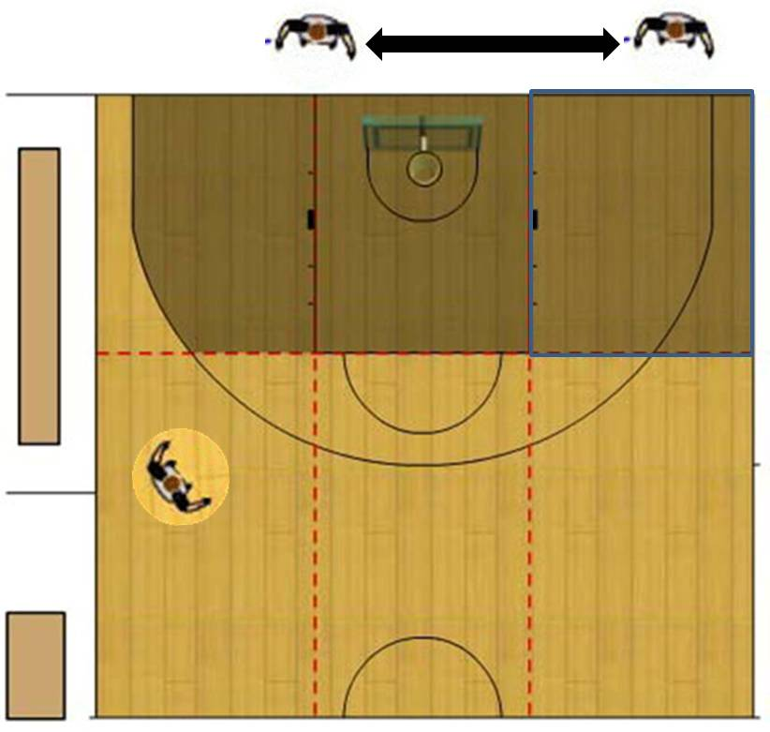
Lead on-ball coverage/movement

Slide 21
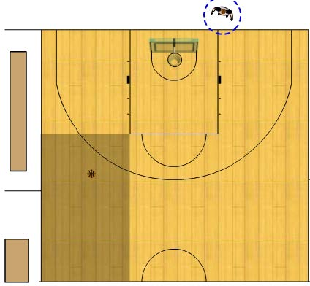
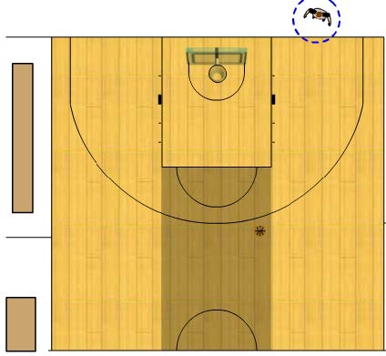
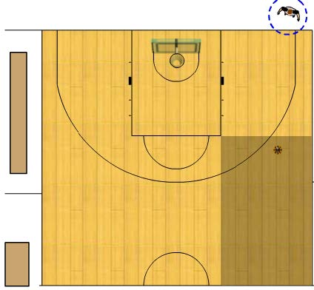
Lead – Ball Areas 1,2 and 3
Close down ball area 1
‘Mirror ball” areas 2 and 3

Slide 22
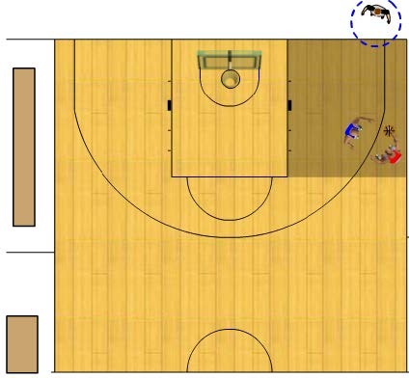
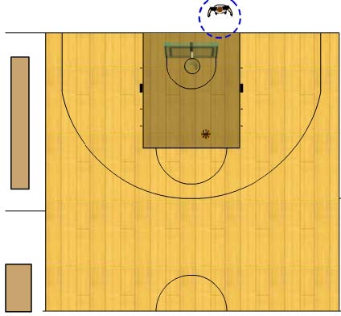
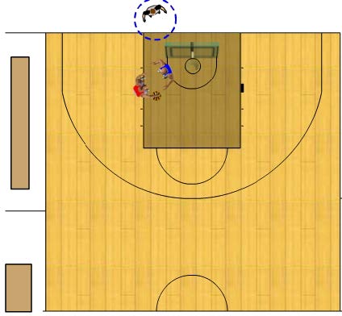
Lead – Ball Areas 4 &5
On-ball – work to see the spaces

Slide 23
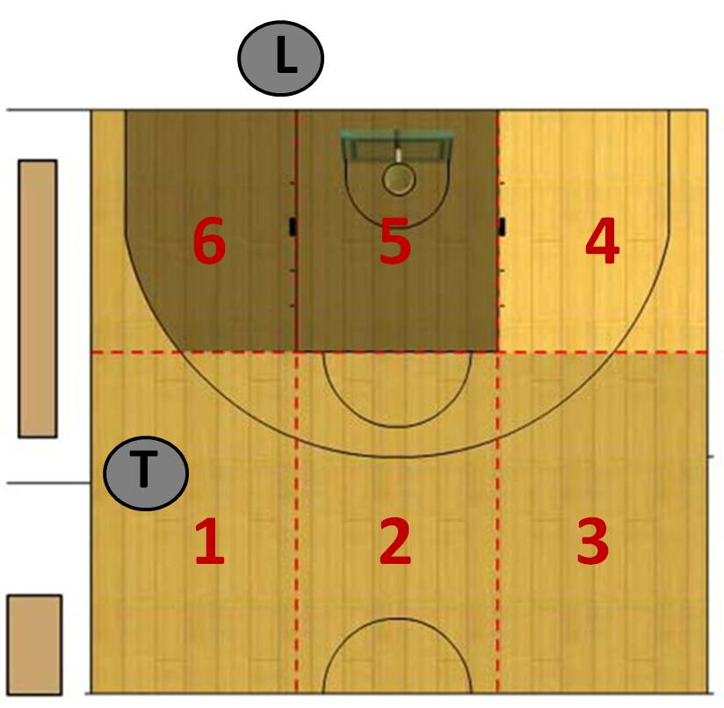
Dual Coverage Area

Slide 24
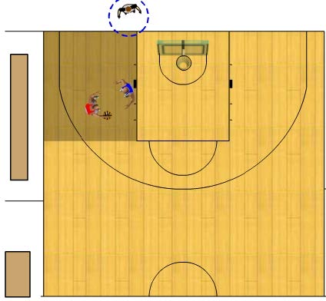
Lead – Ball Area 6
Lead can be on or off-ball when the ball is in Area 6
He is on-ball when the ball is in the low post or the ball is driven to the basket

Slide 25
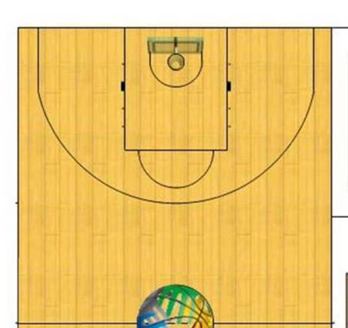
Trail take play to basket; Lead not nearest official
Foul
Trail is nearest official and takes call

Slide 26
Play to basket; Lead is nearest official
Foul
Lead is nearest official;
if unsure who is nearest official – official who play is coming to takes call

Slide 27
Play to basket involving secondary defender
Foul
Play originating in Trail
Secondary Defender
- Lead’s Call

Slide 28
Primary Duties of Lead
Pivot/post play
Play under the basket
Fouls away from trail official
Drive to the basket on lead’s side of the playing court

Slide 29
Practical Advise for Lead
Positioning
When three (3) or more defensive players are pressing in the backcourt, delay progress up the playing court and assist the Trail with coverage
Get down the playing court quickly as possible, allow play to come towards you – “receive the play”
In transition as ‘new lead’, don’t turn your head from the play; keep your eyes focused on the play/players at all times
Try to take a ′deep endline′ position (2 metres if possible) to get the best possible angle. A wider angle means better vision.
Penetrate to the basket when the ball is dribbled from rectangle 4 to 5 to 6. See the ‘start’ and ‘end’ of the drive.
Keep moving, striving for the best possible position - "Go where you need to go in order to see what you need to see."

Slide 30
Practical Advise for Lead
Responsibilities
Line responsibilities
front court endline
closest sideline
centre line (secondary responsibility - ball returned to backcourt i.e. press and transition situations)
Pay particular attention to post play and amount of physical contact you will tolerate. Any rough play should be penalized. Recognize if a player is trying to move to a new position or is being illegally prevented from doing so
Be prepared to help with
twenty-four second device situations
with three-point field goal attempts, particularly when ball is near rectangle 4
Be prepared to give immediate help if/when your partner looks for it on an out-of-bounds play

Slide 31
Press Coverage – backcourt
L
T
Direction of play
when three (3) or more defensive players are in opponents′ backcourt pressing - delay your progress up the playing court in order to help.

Slide 32
Press Coverage – backcourt
L
T
Direction of play
when three (3) or more defensive players are in opponents′ backcourt pressing - delay your progress up the playing court in order to help.

Slide 33
Advise to officials - “calling the game”
See the whole play
Restrict calls to contact that has a direct effect on the play (unless unsportsmanlike).
Avoid penalizing incidental contact that does not affect the play, especially when a player drives to the basket and scores.
Only call what you see; players will over emphasize contact; do not call an offensive foul because a defensive player puts on a theatrical display and falls to the floor.
Watch players’ hands and arms during a shot for a field goal
Remember the cylinder principle and the rights of both players
Screening
Ensure screener stationary
Watch for extended leg, knee or elbow
Post play
Equal rights offense and defense
Call contact with direct affect on play
Don’t allow rough play that impacts control of game

Slide 34
Line Responsibilities
L
T
Lead’s lines
Direction of play
Trail’s lines

Slide 35
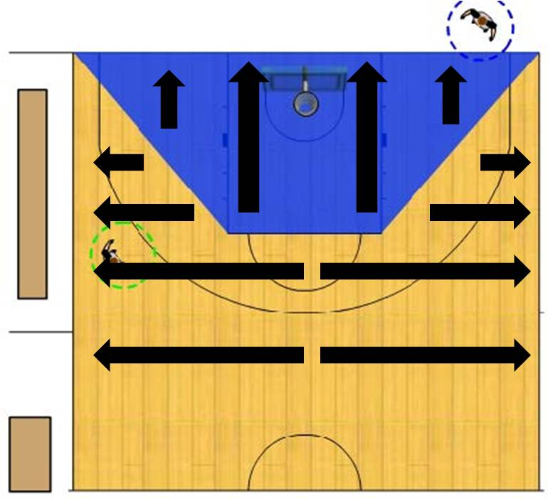
Throw-in Spots
Notes
infractions in semicircle go to nearest sideline
do not administer a throw-in directly behind basket

Slide 36
Backcourt Throw-in
T
L
Old Direction of play
L
Throw-in spot
New Direction of play
T
Reminder: Box-in (physically and/or visually) players on all throw-ins

Slide 37
Backcourt Throw-in
T
L
Throw-in spot
Old Direction of play
T
L
Trail may bounce ball across endline if there is no backcourt pressure
New Direction of play

Slide 38
Backcourt Throw-in
T
Throw-in spot
T
Old Direction of play
New Direction of play
L
Officials rotate if there is backcourt pressure
L

Slide 39
Backcourt Throw-in
Direction of play
T
Trail takes all backcourt throw-ins – may create a rotation
L
Throw-in spot

Slide 40
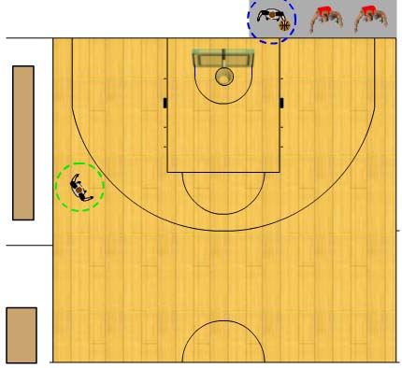
Frontcourt Throw-in
When handing the ball on the endline –
stay between the player and the backboard
‘ass to glass’

Slide 41
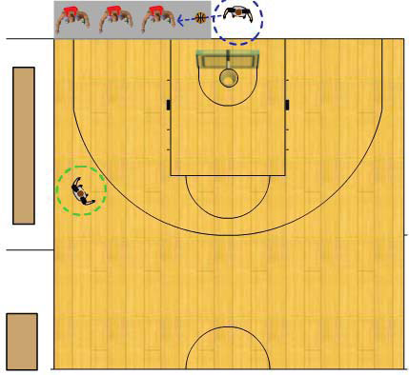
Frontcourt Throw-in
Throw-in spot is on endline between restricted area and sideline to Lead’s right

Slide 42
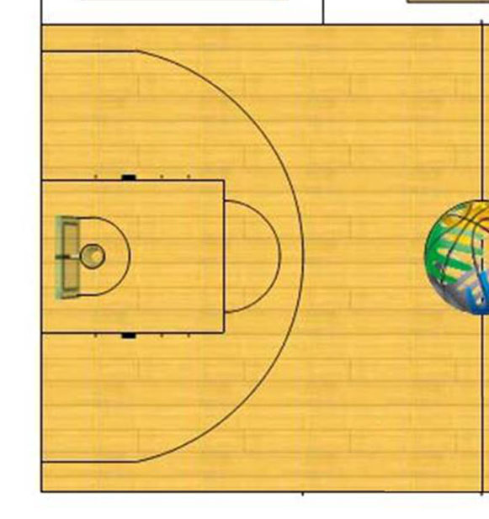
Frontcourt Throw-in Above FT line extended Lead’s Sideline
T
Ball out of bounds to offense
Direction of play
L
Trail administers
throw-in
Creates a rotation
T

Slide 43
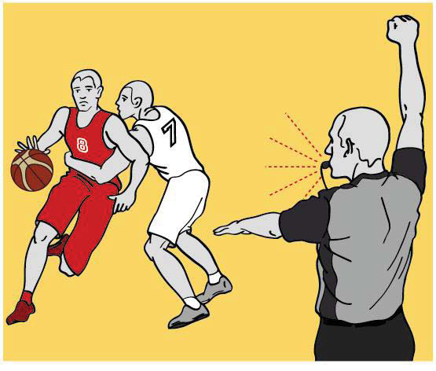
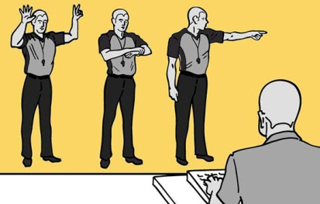
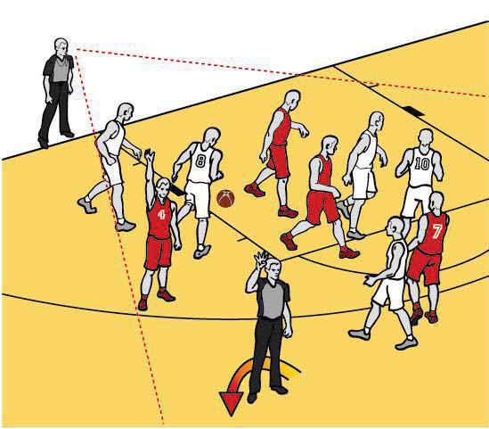
Foul Mechanics
Calling Official
Stop clock: whistle, arm straight up with clenched fist
Point to player’s waist with a straight arm, palm facing down
Indicate number of free throws (if needed)
Hustle/run to spot 6 – 8 m from scorer’s table and STOP
Report while standing still
number of player
type of foul
Number of free throws or direction of play
(If applicable, count basket first)
RUN to next position
Non – calling official
keeps all players with-in field of vision
‘sets table’ as possible for resuming play
Calling official becomes or remains Trail

Slide 44
Simultaneous (Double) Whistles
cooperation and teamwork is vital
must be aware of his partner, whenever there is a double whistle
No immediate signals
establish eye contact
official nearest to the play will normally take the call
if not apparent who is nearest, official who the play is coming to takes the call

Slide 45
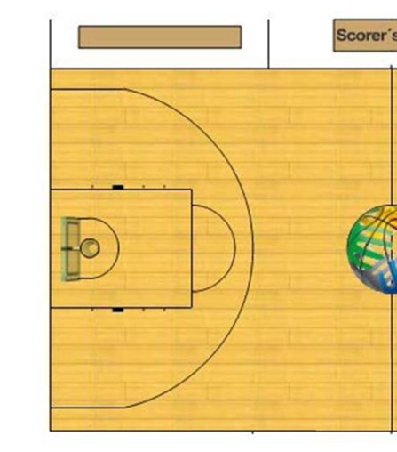
Lead Calls Defensive Foul
Direction of play
Lead reports foul and becomes Trail
L
Foul
T
L
Trail watches players while Lead reports foul and now becomes Lead
T

Slide 46
Lead Calls Offensive Foul
Direction of play
New Direction of play
L
Foul
Lead reports foul and goes back to become Trail
T
Trail watches players while Lead reports foul stays put and becomes Lead
T
L

Slide 47
Trail Calls Offensive Foul
Direction of play
New Direction of play
Lead moves up court - becomes new Lead
L
L
T
Trail reports foul - becomes new Trail
Foul
T

Slide 48
Trail Calls Defensive Foul
Direction of play
Lead stays Lead
L
Foul
T
Trail reports foul and stays Trail
T

Slide 49
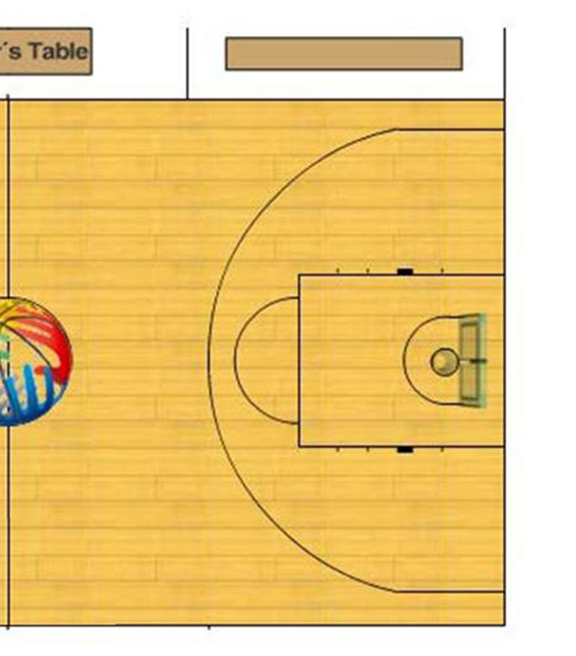
Free Throws and Positioning
Lead: administers FTS
Steps into restricted space
Checks for subs
Indicates # of throws
Bounces ball to thrower and steps back into position
Responsible for players opposite
Trail
opposite table
Indicates # of throws and holds signal until ball released
Responsible time violation but has no visible count
on final throw lifts arm to chop in clock if necessary
steps down on final throw
Responsible for shooter, players opposite
L
T

Slide 50
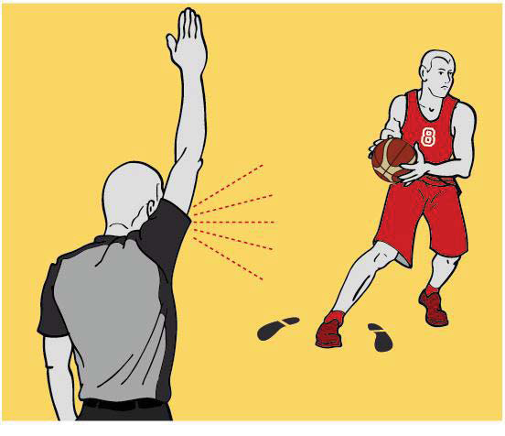
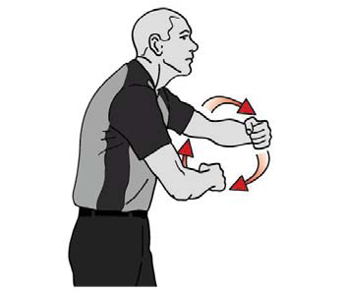
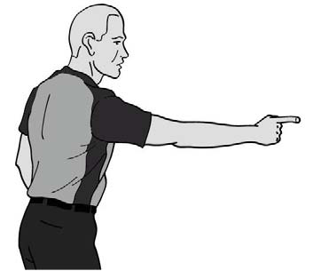
Violation Mechanics
Stop clock:
whistle, arm straight up with open palm and fingers together
Signal nature of violation
Signal direction of play using same arm

Slide 51
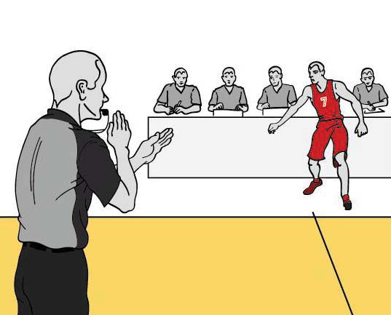
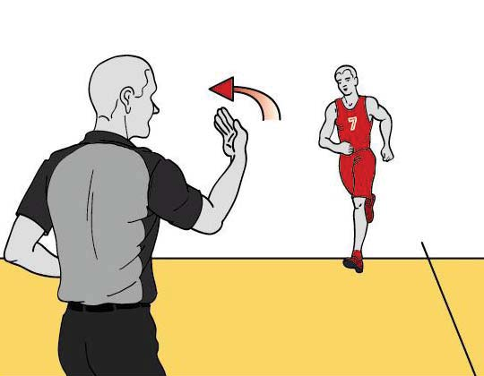
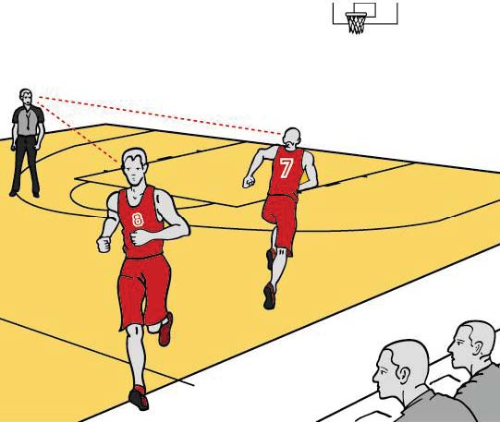
Substitutions
Upon hearing the substitution signal from the scorer, the nearest official
blows whistle and makes time-out signal
beckons substitution(s)
Notes:
Although the coach has primary responsibility for a team having 5 players on the court after a substitution - an ‘ounce of prevention is worth a pound of cure’ and it is recommended to ‘monitor’ the substitutions to avoid an incorrect number of players when play resumes
Officials should work to ensure there is no undue delay and the game resumes as quickly as possible

Slide 52
Granting a Time-out
Upon hearing the time-out signal from the scorer, the nearest official blows whistle and makes time-out signal
Officials move to time-out positions
Timer sounds signal after 50 seconds and the referee blows whistle for players to immediately return to court
Note: if it was a team’s last time out, the referee informs the coach of that

Slide 53
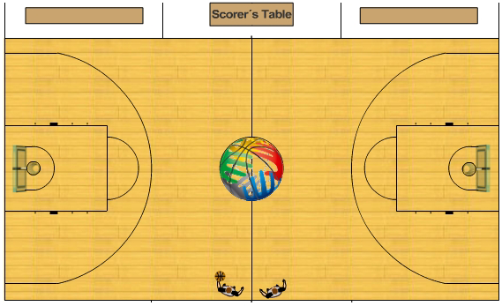
Time Out Positions
Note: officials have ball

Slide 54
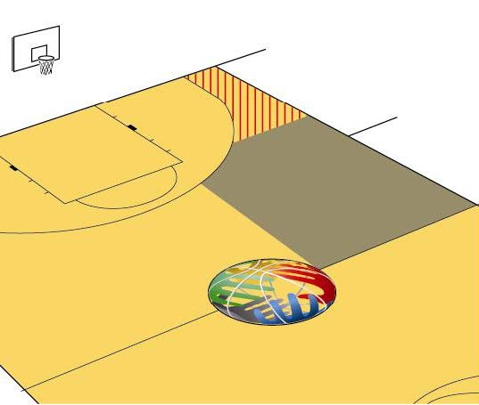
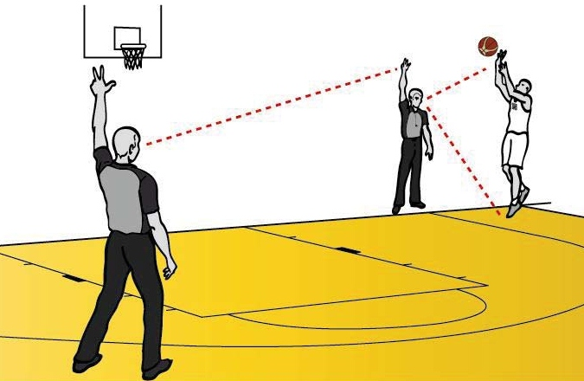
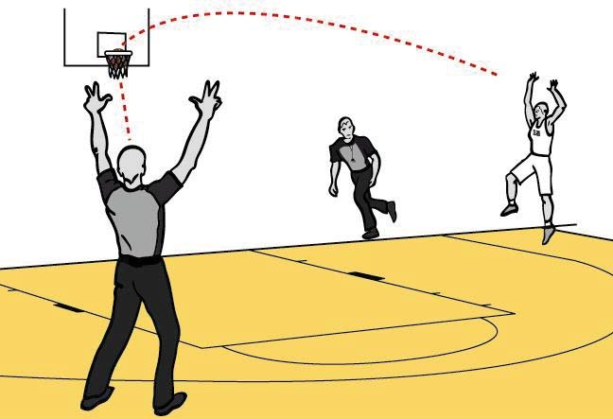
3 Point FG Coverage
L
Trail is primarily responsible for 3-pt attempts
Trail signals all successful goals
Lead signals 3-pt attempt from area 4 and can help with a try in area 3 picked up by Trail
Lead doesn’t signal make
T

Slide 55
Summary and Review
Work as a team
have a pre-game
arrive on floor together; whenever possible, leave court together
co-operate on the floor
make eye contact before administering a throw-in
be aware of players, ball and partner
know areas of responsibility and referee on/off-ball as needed
establish eye contact on double whistles; primary responsibility is 1) nearest official 2) official play going to
give help only when requested

Slide 56
Summary and Review
Calling the game
call fouls that affect the play, ignore incidental contact; call plays that need to be called
establish standards early in the game
don’t allow excessive use of hands
be vigilant in rebounding; gaining an unfair advantage is a foul; ignore contact that isn’t intentional and doesn’t affect play
know where ball is before calling 3 seconds
do not stop the game just to warn a player or a coach regarding conduct. Warn during deadball if necessary. If you stop the game it’s a technical foul.
avoid making foul calls from more than 10 m away i.e. fast break

Slide 57
Summary and Review
Other
Movement
never stop moving. Adjust your position when the ball moves
keep on the move as the play comes towards you and try to maintain the best possible position and a wide angle of vision
Dealing with coaches
do not allow coaches to be the center of attention with theatrical gestures and constant complaining
do not tolerate this behaviour and deal with it ‘sooner than later’
when the coach tries to intimidate or harass you it warrants a technical foul
Reporting fouls
confirm with the scorer whether it is the 4th or 5th team player foul before indicating the penalty.
slow down your signals to the scorer, especially when giving the player’s number.

Slide 58
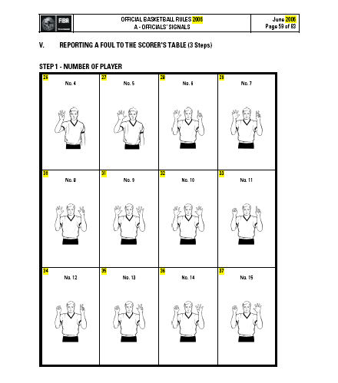

Slide 59
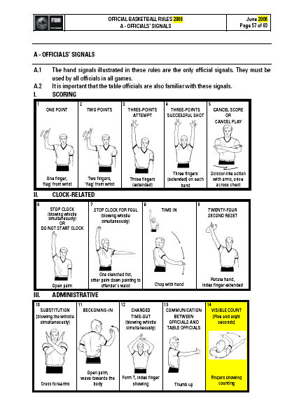

Slide 60
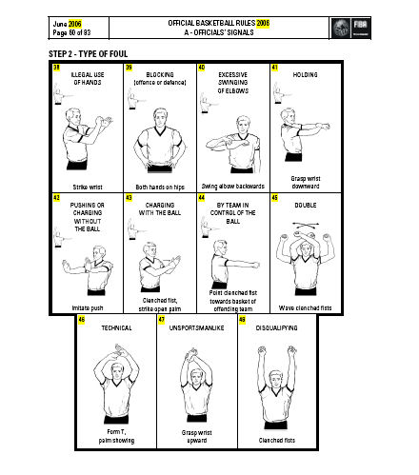

Slide 61
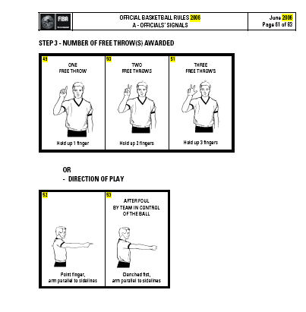

Slide 62
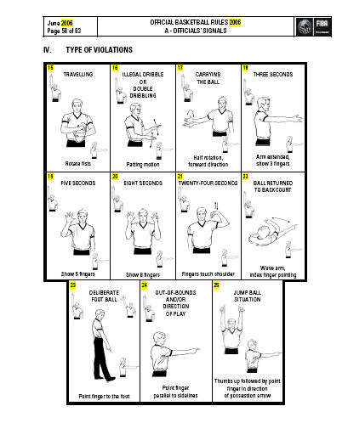

Slide 63
